Slide 1
Memory representation of basic data
Mohammad Shahid Qureshi
NU-FAST

Slide 2
Representation for Hexadecimal
Binary | Hex | Binary | Hex
0000 | 0 | 1000 | 8
0001 | 1 | 1001 | 9
0010 | 2 | 1010 | A
0011 | 3 | 1011 | B
0100 | 4 | 1100 | C
0101 | 5 | 1101 | D
0110 | 6 | 1110 | E
0111 | 7 | 1111 | F

Slide 3
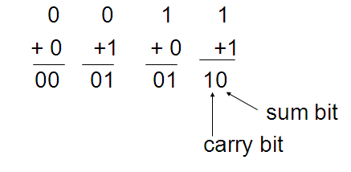
Binary addition
Addition table for binary digits:

Slide 4
Multi-bit binary addition
When adding binary numbers if a carry is generated, it is carried one position to the left, just as in decimal arithmetic
Example 1 1 1
X 173 1 0 1 0 1 1 0 1
+ Y 44 0 0 1 0 1 1 0 0
217 1 1 0 1 1 0 0 1

Slide 5
Signed number representation
In ordinary arithmetic, a negative number is indicated by a minus sign and a positive number by a plus sign
In computers, the convention is to represent the sign with an extra bit
We’ll look at two different representations for negative numbers
  Signed Magnitude (SM)
  2’s complement

Slide 6
Signed-Magnitude (SM) Representation
Idea: The leftmost bit represents the sign (0 = plus, 1 = minus) and the rest of the bits represent the number
Example:
Sign bit = 0 = +
5 magnitude bits
(+22)₁₀ = (0 1 0 1 1 0)_{SM}
(-22)₁₀ = (1 1 0 1 1 0)_{SM}

Slide 7
2C Example
6-bit representation of decimal 22:
Sign bit = 0 = +
5 magnitude bits
(+22)₁₀ = (0 1 0 1 1 0)_{2C}
(-22)₁₀ = 1 0 1 0 0 1 2’s complement of
+ 1 of (0 1 0 1 1 0)
= (1 0 1 0 1 0)_{2C}
sign bit = 1 = -ve

Slide 8
SM vs Complement representation
Addition in SM requires a comparison of the signs and the magnitude, then either addition or subtraction
Addition in 2C does not require a comparison or subtraction
Most computers use 2C rather than SM, because the SM make the circuit for addition/subtraction calculation unnecessarily complex

Slide 9
Float representation

Slide 10
Problem: How to store real number in the memory
12.39

Slide 11
Some basics
Any real number can be represented in the scientific notation
Example:
156.78 as 0.15678x10³
0.0294 as 0.294x10⁻¹
Similarly in binary
12.39₁₀ = 1100.0110₂
Can be represented as
1.1000110 x 2³
m ^{e}
exponent
(integer)
mantissa
(fraction)

Slide 12
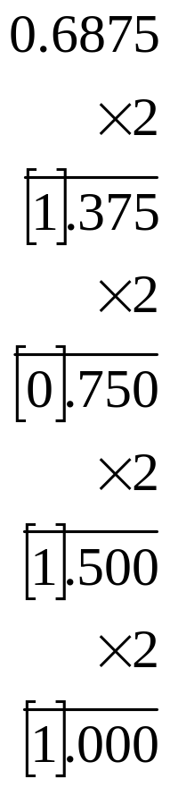
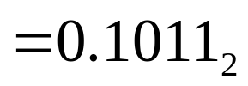
Converting decimal fraction to binary
To convert decimal fractions to binary fraction, continually multiply fraction by base (2). The integer parts of the results give the digits from right to left.

Slide 13
Example
12.39₁₀
Separate the integer and fraction part
Convert the integer part
12₁₀ = 1100₂
Convert the fractional part
0.39
* 2
0.78
* 2
1.56
* 2
1.12
* 2
0.24
0.39₁₀ = 0110₂
12.39₁₀ = 1100.0110₂

Slide 14
IEEE 754 single precision format (32-bit format) for Floating Point numbers
1-bit for the sign
8-bits for the exponent (including its sign)
23-bits for the mantissa (between 0 & 1)
Exponent(23-30)
Fraction (0:22)
Sign (31)

Slide 15
IEEE 754 single precision format (32-bit format) for Floating Point numbers
The Exponent is represented as Excess Notation
To get rid of dealing with negative powers, the powers in the range of -127 to +127 are shifted to 0 to 255
For 8-bits exponent, Excess is 2⁸⁻¹ -1=127
How to get 8-bit Exponent in excess notation?
  Determine the decimal value of exponent
  Add 127
  Convert to its binary equivalent

Slide 16
Example: 8.125
31
0
Exponent(8 bits)
Fraction (23 bits)
Sign (1 bit)
Write 8.125 as a binary number:
1000.001 = 1.000001•2³
Sign Bit:
0
Mantissa:
.000001
Exponent:
3+127 = 130 =10000010
1 bit
8 bit
23 bit
Result:
01000001000000100000000000000000

Slide 17
Example: −16.25
31
0
Exponent(8 bits)
Fraction (23 bits)
Sign (1 bit)
Write 16.25 as a binary number:
10000.01 = 1.000001•2⁴
Sign Bit:
1
mantissa:
.000001
Exponent:
4+127 = 131 =10000011
1 bit
8 bit
23 bit
Result:
11000001100000100000000000000000

Slide 18
Mantissa Representation
How many choices at the most significant position?
That is, there is only one choice at the most significant place
i.e; 1
So if it always has to be 1, then storing it will be redundant

Slide 19
Float rounding
float f = 16.7
cout << f; // prints 16.700001
The reason for this is the rounding being done in the binary
  0.7 translation into binary results in an infinite sequence of bits
  With limit of 23 bits for mantissa, the binary rep of 0.7 has to be stopped and rounded, resulting in the value of 16.700001

Slide 20
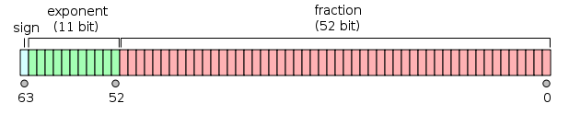
Double type
Occupies 8 bytes of memory

Slide 21
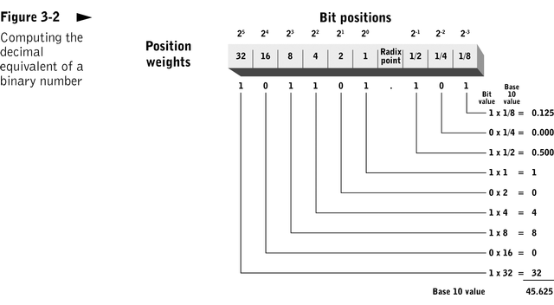
Some basics

